Slide 1
PROJECT 4 - SEO AUDIT & OPTIMIZATION FOR ORGANIC TRAF
HTTPS://WWW.SALESFORCE.COM/IN/

Slide 2
TABLE OF CONTENTS
Company selection
Initial Audit
Keyword Research
On-Page SEO Optimization Audit
Techincal SEO
Content Stratergy
Off Page SEO

Slide 3
COMPANY SELECTION
Company selection
I have selected the company “Sales Force”(https://www.salesforce.com/in/for this SEO project.
Overview:
Salesforce.com is a leading cloud-based customer relationship management (CRM) platform that provides businesses with tools to manage sales, customer service, marketing automation, analytics, and application development. It empowers companies to improve customer engagement, streamline operations, and drive growth.
Global Reach:
Salesforce serves organizations of all sizes across various industries worldwide, including finance, healthcare, retail, and technology. It has a significant presence in North America, Europe, and Asia-Pacific.

Slide 4
ABOUT COMPANY
Core Services
CRM Solutions ,Sales Cloud ,Service Cloud, Marketing Cloud, Tableau Analytics & Customer 360
Competitors
Microsoft Dynamic 365 ,Hubspot CRM ,Zono CRM ,Oracle Netsuite CRM ,Zendesk Sell & Pipedrive

Slide 5
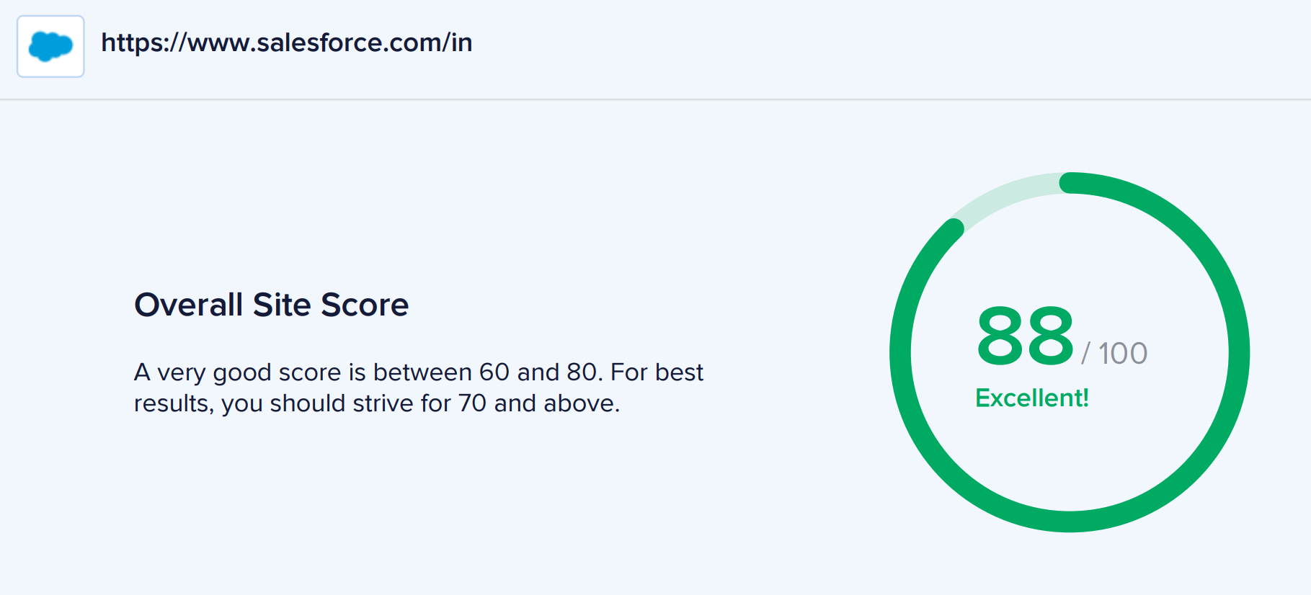
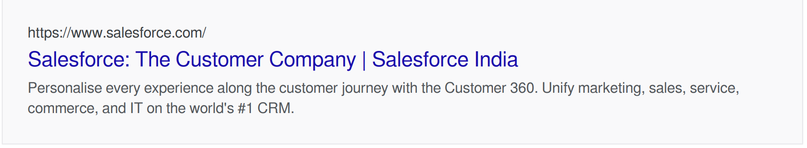
INITIAL AUDIT
Here I show the site may appear in search results

Slide 6
INITIAL AUDIT
Current Performance:
Domain Rating (DR): Salesforce has a DR of 92 according to Ahrefs, indicating an exceptionally strong backlink profile. This high score suggests it ranks well due to numerous high-quality backlinks from authoritative source.
Traffic: Salesforce attracts significant monthly organic traffic, estimated at over 8 million global visitors, highlighting its strong SEO visibility.
Keyword Strength: Salesforce ranks for thousands of keywords, with a strong presence in high-volume, competitive terms related to CRM (Customer Relationship Management), cloud solutions, and enterprise software【39】【41】
Strengths:
Well-optimized for branded keywords.
Uses minified JavaScript/CSS and HTML compression, improving site efficiency.
Excellent Cumulative Layout Shift (CLS) score of 0.0004, ensuring minimal visual instability.
Weaknesses:
Slow Load Speed: 10.34 seconds, significantly above the recommended 5 seconds【8】.
Large DOM Size: Over 16,000 nodes, impacting page speed【8】.
Image Optimization: Lacks modern formats like WebP【8】.
Cache Headers: Missing for images and scripts, reducing efficiency for return visitors【8】.

Slide 7
TASK 2 – KEYWORD RESEARCH
Here are the most common keywords we found on the page:
Keyword
crm software ,crm system, salesforce crm , crm tools ,crm platforms ,salesforce commerce cloud, crm programs, sfdc, salesforce trailhead,cpq salesforce
Competitors
Zoho CRM, Hubspot CRM, Freshworks CRM,Microsoft dynamic 365, Pipe drive
Competitor Analysis :
Target long-tail and localized keywords.
Focus more on educational and transactional content for Indian businesses.
Expand its presence in markets underserved by competitors, such as smaller cities and specific industries like retail, education, and healthcare.

Slide 8
TASK 2 – KEYWORD RESEARCH
Primary Keywords
CRM software ,CRM system, Salesforce CRM ,Salesforce Commerce Cloud, CPQ Salesforce, SFDC (Salesforce Dot Com),Salesforce Trailhead
Secondary Targeted Keywords
CRM tools for small businesses, AI in CRM ,CRM automation software, Salesforce pricing,Configure Price Quote software, Customer data platform (CDP), Salesforce integrations, Salesforce Analytics Cloud, Marketing automation CRM
Longtail keywords
How to implement CRM software for small business, Benefits of using Salesforce Commerce Cloud for e-commerce, Best practices for Salesforce CPQ implementation, How to become Salesforce certified with Trailhead, Salesforce CRM vs HubSpot CRM comparison, Best CRM platforms for startups in 2024, How to automate sales process with Salesforce tools, Data-driven sales strategies using Salesforce CRM,How to align sales and marketing with Salesforce.

Slide 9
TASK 3.1 - ON-PAGE SEO OPTIMIZATION AUDIT:
Selected Pages https://www.salesforce.com/in/editions-pricing/overview/
Strength:
Keywords: One or more keywords found in titlr snf description of the page .Title – salesforce,pricing. Description –pricing,salesforce
Headings: Proper hierarchy (H1, H2 seen in page etc.).
Links : Page has a correct number of internal (94)and external link(6)
Weekness:
Title Tag: Not properly optimized –Too Long- 81characters (Recommended length: 50-60 characters)
Meta Description: Not properly Optimised – Too Long – 322 Characters. (Recommended length: 150-160 characters)
Java Script - Some Javascript files don't seem to be minified
Alt Attribute : Some images on the page have no alt attribute. (8

Slide 10
TASK 3.1 - ON-PAGE SEO OPTIMIZATION AUDIT:
Recommendations
Make sure every image has an alt tag, and add useful descriptions to each image. Add your keywords or synonyms
Tracking down where the un-minified JavaScript files come from.
Try to replace embedded objects with HTML5 alternatives.

Slide 11
TASK 3.2 - ON-PAGE SEO OPTIMIZATION AUDIT:
Selected Pages : https://www.salesforce.com/in/solutions/industries/
Strength:
Title Tag: The SEO title is set and is 69 characters long.
Meta Description: The meta description is set and is 150 characters long.
Keywords: One or more keywords found in title and description of the page .Title –crm,solutions,salesforce. Description –solutions, industry,customer.
Headings: H2 tags were found on the page.
Links : Page has a correct number of internal (75)and external link(11)
Weekness:
Headings: 3 H1 tags were found. For the best SEO results there should be exactly one H1 tag on each page.
Alt Attribute : Some images on the page have no alt attribute. (3)

Slide 12
TASK 3.2 - ON-PAGE SEO OPTIMIZATION AUDIT:
Recommendations
Ensure your most important keywords appear in the H1 tag.
Make sure every image has an alt tag, and add useful descriptions to each image. Add your keywords or synonyms
Tracking down where the un-minified JavaScript files come from.
Try to replace embedded objects with HTML5 alternatives.

Slide 13
TASK 3.3 - ON-PAGE SEO OPTIMIZATION AUDIT:
Selected Pages https://www.salesforce.com/in/customer-success-stories/#!page=1
Strength:
Title Tag: The SEO title is set and is 63 characters long.
Meta Description: The meta description is set and is 134 characters long.
Keywords: One or more keywords found in title and description of the page .Title – salesforce,success, customer. Description - Business
Headings: Proper hierarchy (H1, H2 seen in page etc.).
Links : Page has a correct number of internal (52)and external link(09)
Weekness:
Alt Attribute : Some images on the page have no alt attribute. (2)

Slide 14
TASK 3.3 - ON-PAGE SEO OPTIMIZATION AUDIT:
Recommendations
Make sure every image has an alt tag, and add useful descriptions to each image. Add your keywords or synonyms
Tracking down where the un-minified JavaScript files come from.
Try to replace embedded objects with HTML5 alternatives.

Slide 15
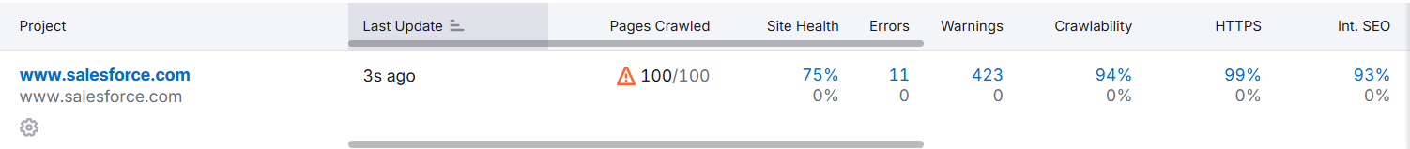
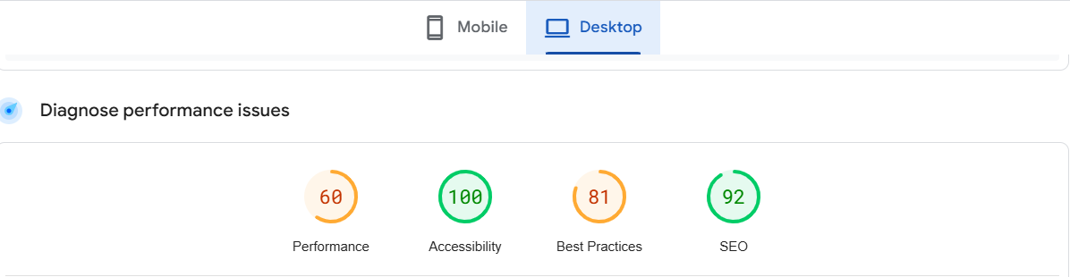
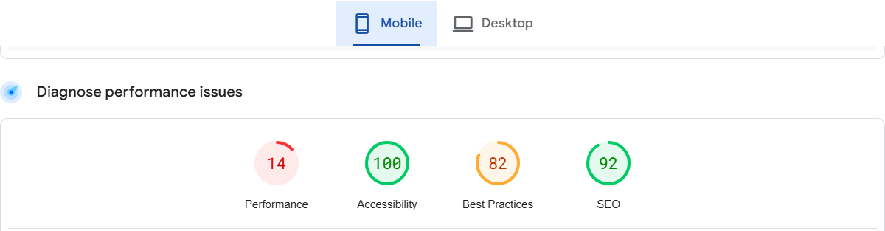
TASK 4 - TECHNICAL SEO
Technical Analysis

Slide 16
TASK 4 - TECHNICAL SEO
Technical SEO Issues
Page 1 : https://www.salesforce.com/in/
Page Speed: Opportunities for improvement include optimizing images and JavaScript to reduce load times.
Missing Alt Attributes: Some images lack descriptive alt texts, which can impact accessibility and SEO.
Page 2 : https://www.salesforce.com/in/editions-pricing/overview/
Content-to-Code Ratio: Could be optimized by reducing redundant HTML.
Broken Links: No identified broken links, but continuous checks are advised
Page 3 : https://www.salesforce.com/in/company/contact-us/?d=cta-header-9
Mobile Usability: The mobile responsiveness is generally good, but improving interactive elements like buttons would enhance UX.
Meta Robots Tag: Ensure "index, follow" settings are active.
Page 4 : https://help.salesforce.com/s/?language=en_US
Canonical Tags: Ensure proper implementation to prevent duplicate content issues.
Breadcrumb Navigation: Can be further enhanced for better internal linking.

Slide 17
TASK 4 - TECHNICAL SEO
Technical SEO Issues Recommendation
Regularly run page speed tests with tools like Google PageSpeed Insights or GTmetrix to identify ongoing issues and monitor progress.
Regularly audit the site using tools like Screaming Frog to detect missing alt attributes and update them.
Focus on delivering valuable content with clean, efficient code to improve the ratio and user experience.
Design with a mobile-first approach, ensuring the website is fully responsive on various screen sizes.
Regularly review and update canonical tags to avoid duplicate content penalties.
Ensure breadcrumbs are consistent across all pages and visible at the top of each page.

Slide 18
TASK 4 - TECHNICAL SEO
5 Best Practices to Improve Site and Web Page Speed:
Optimize images: Images can often be one of the biggest culprits when it comes to slow page load times. There are a number of ways to optimize images for the web, such as compressing them and using the right file format.
Minify code: Minifying code involves removing unnecessary characters from your website's code, such as whitespace and comments. This can help to reduce the size of your code files and improve page load times.
Enable browser caching: Browser caching allows browsers to store frequently accessed files on the user's computer. This can help to improve page load times for returning visitors.
Reduce HTTP requests: The more HTTP requests that a page has to make, the slower it will load. There are a number of ways to reduce HTTP requests, such as combining multiple CSS and JavaScript files into a single file.
Use a CDN: A content delivery network (CDN) is a network of servers that store copies of your website's content around the world. This can help to improve page load times for users who are located far away from your web server.

Slide 19
TASK 5 - CONTENT STRATEGY
Keyword
crm software ,crm system, salesforce crm , crm tools ,crm platforms ,salesforce commerce cloud, crm programs, sfdc, salesforce trailhead,cpq salesforce

Slide 20
TASK 5 - CONTENT STRATEGY
Blog topic
Top Features to Look for in a Modern CRM Software in 2024
10 Powerful Salesforce CRM Tools You Should Be Using
Why CPQ is the Secret to Faster Sales Cycles
Learning Salesforce: How Trailhead Can Accelerate Your Career
How Salesforce CRM Is Transforming Healthcare and Finance Industries

Slide 21
TASK 5 - CONTENT STRATEGY
Content Strategy Recommendations:
SEO Optimization: Use keywords like "best CRM software," "Salesforce integrations," and "CPQ solutions."
Content Formats: Publish blog posts, whitepapers, video tutorials, and interactive guides.
Distribution Channels: Promote via email newsletters, LinkedIn articles, and Salesforce community forums.

Slide 22
TASK 6 –OFF PAGE SEO
Building Authority: Through high-quality backlinks from guest blogging, directory submissions, and influencer partnerships.
Brand Awareness: By leveraging social media, content marketing, and online reviews.
Community Engagement: Active participation in industry forums, local events, and networking opportunities.
Local Optimization: Optimizing for local SEO to attract Indian businesses.
Reputation Management: Monitoring and responding to brand mentions and reviews to maintain a positive image.

Slide 23
RECOMMENDATIONS & NEXT STEPS
Continuous improvement of page load speed and mobile responsiveness.
Regular audits using tools like Screaming Frog for detecting SEO issues.
Expanding the content strategy to include interactive formats and leveraging social media for distribution.

